Slide 1




Customer Churn Prediction and Retention Analysis in Telecom
End-to-End Machine Learning Classification Project
ONL4_AIS4_G2 (Team 2)
Supervised by: Eng. Ahmed Salem
Mohamed Ahmed Mohamed Elshahat
Amir Ibrahem Abdulraouf
Salma Elbadry Ibrahim
Sara Abdelmoniem Omar
Mohamed Ahmed El-Quasaby
Mohamed Salah Othman Mohamed

Slide 2



Business Problem
Customer churn is a major challenge for telecom companies.
Losing customers reduces long-term revenue and increases acquisition costs.
Retaining existing customers is cheaper than acquiring new customers.
The goal of this project is to predict which customers are likely to churn.

Slide 3
Dataset Overview
Utilizing the standard IBM Telco Customer Churn dataset to model behavior and demographics.
7043 customer records & 21 features.
Target variable: Binary Target Churn (Yes/No)
Category | Description | Key Features
Demographics | Individual customer traits | Gender, Senior Citizen, Partner, Dependents
Services | Subscribed product details | Phone, Internet (DSL/Fiber), Tech Support, Streaming
Billing information | Contractual info | Tenure, Contract, Payment Method
Account | Financial info | Total Charges, Monthly Charges

Slide 4








Project Workflow

Slide 5

Data Cleaning
Checked missing values.
Data Quality Alert
Detected null values in TotalCharges.
11 missing values were identified in TotalCharges for customers with zero tenure. These were imputed with 0 to maintain dataset integrity.
Fixed incorrect data types.
Verified no duplicate records across 7,043 rows.

Slide 6
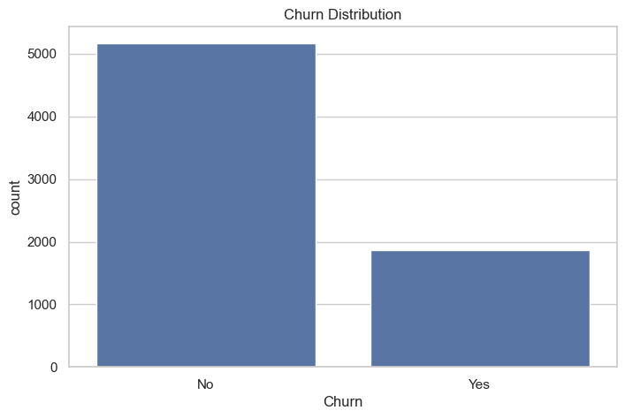
EDA — Customer Churn Distribution

Slide 7
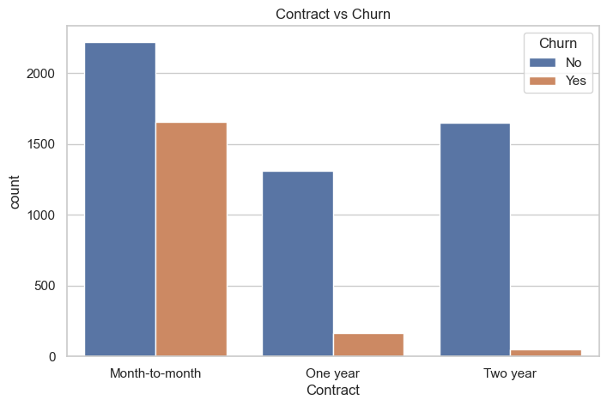
EDA — Contract Type VS Churn

Slide 8
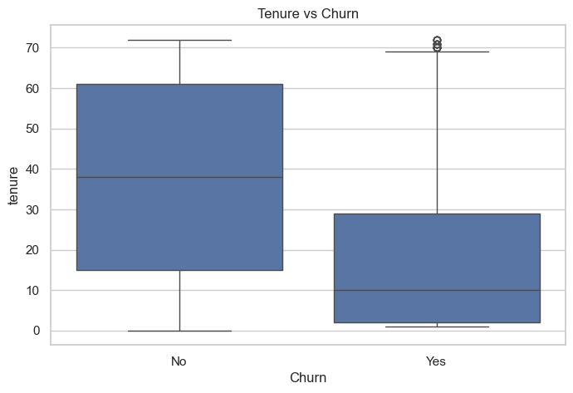
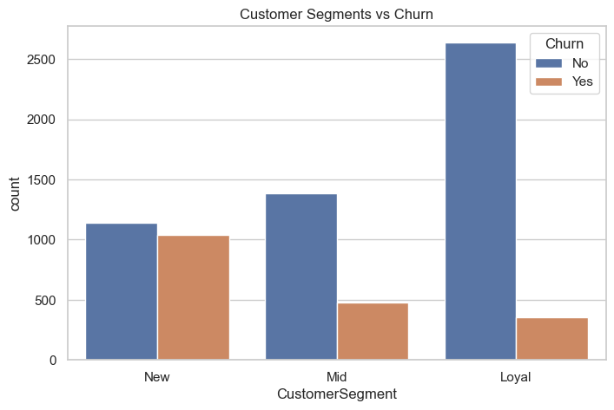
EDA — Tenure & Customer Segments VS Churn

Slide 9
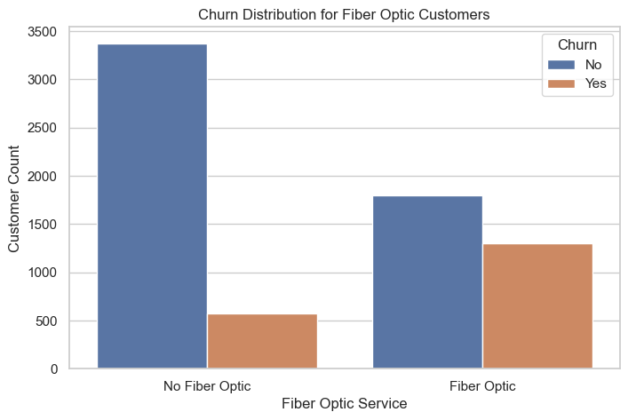
EDA — Fiber Optic VS Churn

Slide 10
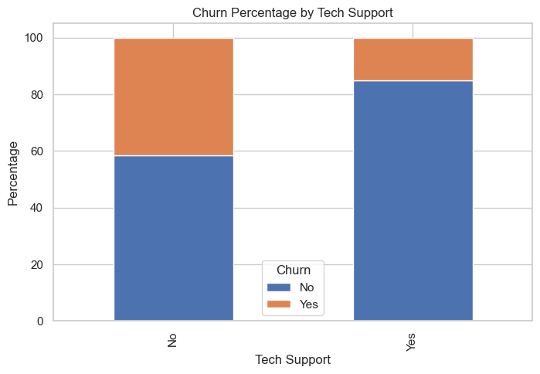
EDA — Tech Support VS Churn

Slide 11
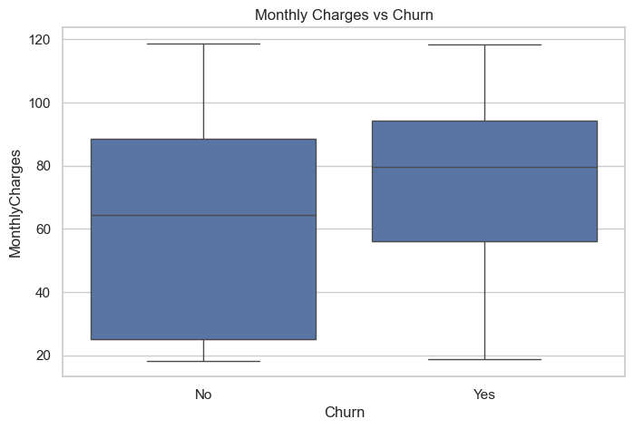
EDA — Monthly Charge VS Churn

Slide 12
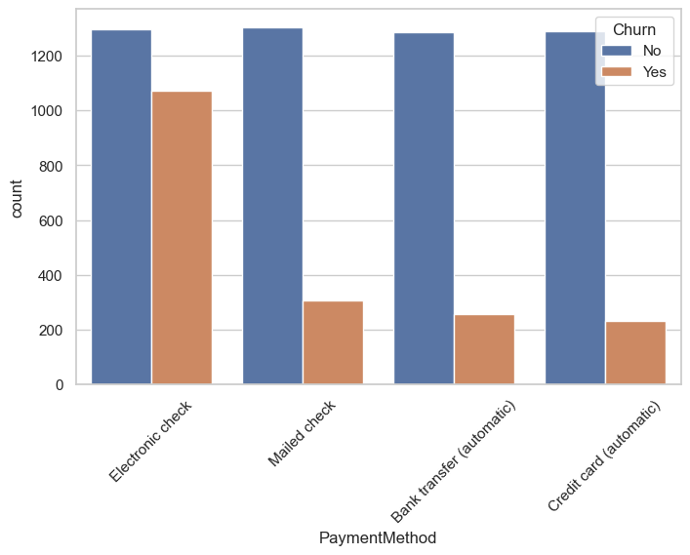
EDA — Payment Method VS Churn

Slide 13
Key Insights from EDA
Month-to-month contracts increase churn risk.
Additional services reduce churn probability.
New customers are more likely to leave.
Customers who use Electronic Check have a higher churn rate.
Fiber optic users have higher churn tendency.
High monthly subscription prices contribute to increased churn.

Slide 14
Business Recommendations
Encourage long-term contracts.
Promote bundled support services.
Improve onboarding for new customers.
Encourage Auto-pay/Credit Card over Electronic Check.
Improve fiber optic customer experience.
Introduce flexible pricing plans, loyalty discounts, or bundled offers for customers with high monthly charges to reduce churn risk.

Slide 15

Preprocessing
Scaling & Encoding
Engineered Features
Standard Scaler for numerical features.
IsNewCustomer
HasFiberOptic
OneHotEncoder for categorical features.
HighMonthlyCharges
LongTermContract
Label Encoding for the target variable.
NumServices
AutoPayment

Slide 16
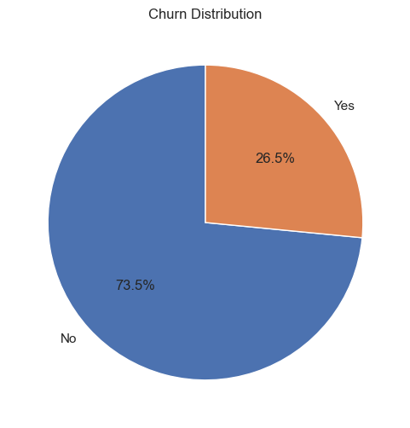
Preprocessing — Class Imbalance Problem
The dataset is inherently imbalanced, with churned customers forming the minority class.
Accuracy Trap: High accuracy can be misleading if the model fails on the minority class.
Priority: Detecting true churners (Recall) is more valuable than overall accuracy.

Slide 17

Preprocessing — Train-Test Split
80%
20%
Training Set
Test Set
Random State = 42 used to ensure full reproducibility of results across experiments.
Stratify = y used to preserve the original class distribution in both training and testing sets.

Slide 18
Machine Learning Models
Model | Architecture | Specific Purpose
Logistic Regression | Linear Classifier | Baseline performance & interpretability.
Balanced LogReg | Linear + Class Weights | Addressing data imbalance directly.
Random Forest | Ensemble Bagging | Capturing non-linear feature interactions.
XGBoost | Gradient Boosting | Optimizing performance via tree ensembles.

Slide 19




Evaluation Metrics
Precision
Recall
F1-Score
ROC-AUC
Minimizing false positives (unnecessary retention offers).
Minimizing false negatives (missing actual churners). Highest Business Impact.
Harmonic mean balancing precision and recall.
Model's ability to distinguish between classes.

Slide 20
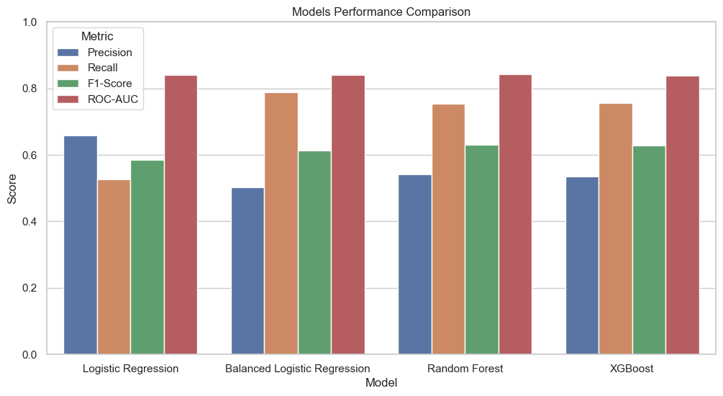
Model Comparison — Metrics

Slide 21
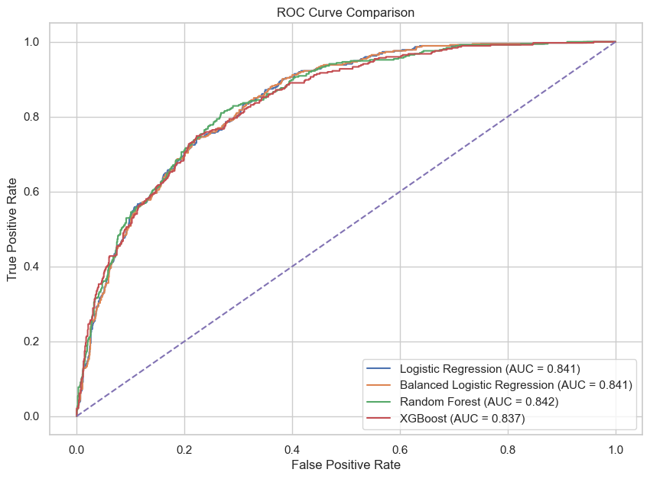
Model Comparison — ROC Curve

Slide 22

Final Model Selection
Random Forest
Consistent performance across all subsets.
Built-in protection against overfitting.
Primary Classifier
Provides clear Feature Importance.
High Recall for churn detection.

Slide 23
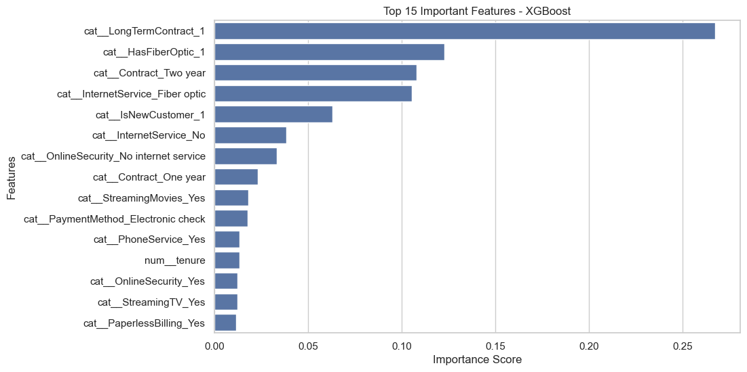
Feature Importance Analysis

Slide 24
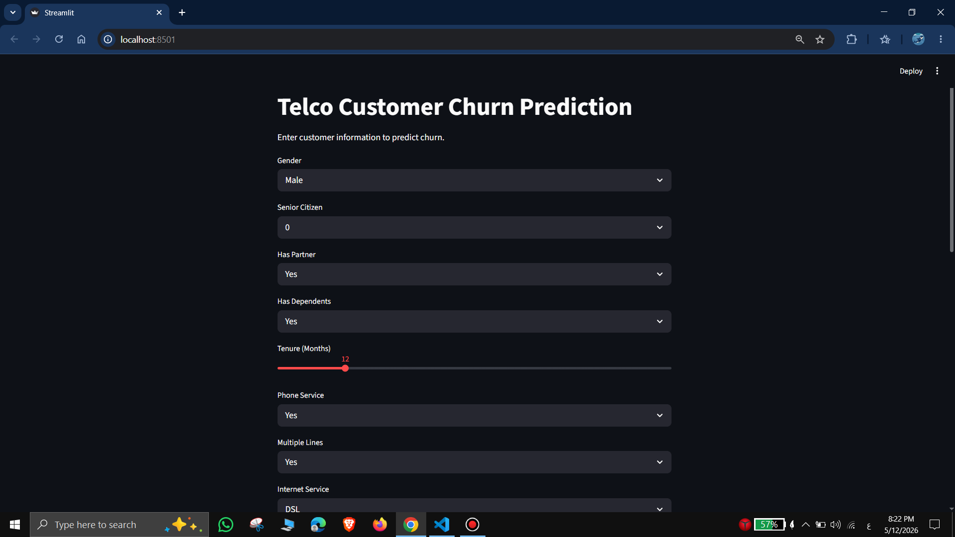
Model Deployment
Interactive Streamlit application providing a user-friendly interface for real-time customer churn prediction.
Integrated tuned Random Forest model with automated data preprocessing pipeline.
Supports business teams in taking proactive customer retention and decision-making actions.

Slide 25
Conclusion
Generated actionable business insights.
Identified major churn factors.
Successfully predicted customer churn.
Built end-to-end ML pipeline.

Slide 26

Thank You
Questions & Discussion

